Slide 1
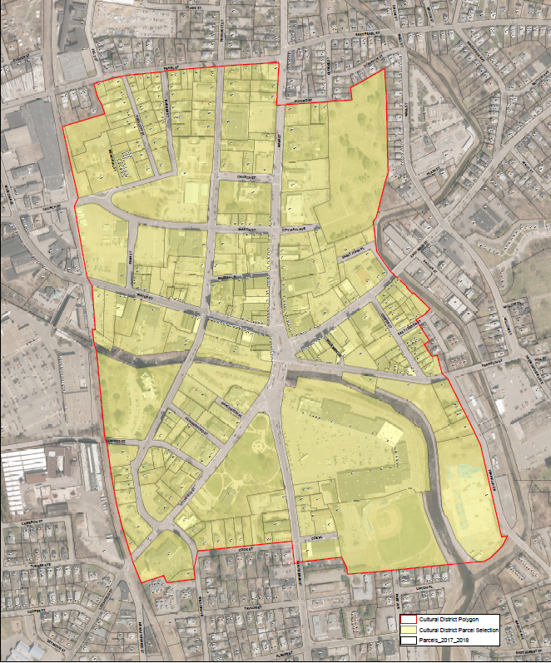
Torrington Cultural District Presentation
September 9, 2021

Slide 2
What is a cultural district
Cultural district definition
Reasons to form a cultural district
Standards and criteria for the formation of a cultural district
Cultural Asset inventory and map requirements
Cultural Committee Requirements

Slide 3
Connecticut Cultural District Program
A cultural district is a specific area of a city or town identified by the municipality that has:
A number of cultural facilities, activities, and assets both non-profit and for profit
Is a walkable compact area easy for visitors to recognize
Is a center of cultural activities: artistic and economic
A place where the community congregates and visitors enjoy the places that makes a community special
Legislation is effective October 2019
An Act Concerning the Establishment of Municipal Cultural Districts
State Office Responsible
Department of Economic and Community Development
Local Groups Responsible
City of Torrington
Cultural District Committee
NWCT Arts Council

Slide 4
Connecticut Cultural District Program
Reasons to Establish a Cultural District Include
Market arts and culture attractions to visitors
Promote and encourage artists, entrepreneurs and creative businesses
Promote tourism and increase visitation
Improve community health and wellness for residents
Strengthen the distinctive character of communities
Create a plan to drive economic growth and expand tax base
Support Sustainable CT certification
Contribute to the region and state’s cultural assets
Highlight the culture and history of the community
State Office Responsible
Department of Economic and Community Development
Local Groups Responsible
City of Torrington
Cultural District Committee
NWCT Arts Council

Slide 5
Connecticut Cultural District Program
Standards and Criteria
Municipality must be in Connecticut
Must have defined boundaries
Must be walkable and accessible
Must have cultural facilities and assets
Should have public infrastructure and amenities
Must hold at least one community input meeting for people to learn about proposed district and goals
Municipality must vote to approve Cultural District by passing a resolution following community meeting
Municipality must form a Cultural District Commission
The District must meet the definition explained earlier
Districts can span more than one town/city, but both municipalities must have a supporting resolution. A town can have multiple cultural districts as well.
State Office Responsible
Department of Economic and Community Development
Local Groups Responsible
City of Torrington
Cultural District Committee
NWCT Arts Council

Slide 6
Connecticut Cultural District Program
Inventory of cultural assets must be identified and included on a map
Defines the cultural assets in the district
Can be a GIS map, or google map
Work with the local Designated Regional Service Organization (NWCT Arts Council) to help identify and develop the list of assets.
Map shows the boundaries of the cultural district and where the district is located in the municipality and include a key to the assets and define a scale of distance.
Assets include:
Cultural facilities
Artistic Spaces
Creative Businesses
Historic Sites
Locations of cultural activities (indoor and outdoor)
Maps can mark cultural assets located outside the proposed district on the map
State Office Responsible
Department of Economic and Community Development
Local Groups Responsible
City of Torrington
Cultural District Committee
NWCT Arts Council

Slide 7
Connecticut Cultural District Program
Municipality must establish a Cultural District Commission can be one of the following models
Create new Board/Commission in accordance with local charter requirements
Assign to an existing Board/Commission and create an Advisory Council subcommittee reporting to the existing Board/Commission.
Assign Cultural District oversight to an existing Board/Commission if it can meet the community representation requirement, can be an existing entity or governing body.
Purpose of Cultural District Commission is to exercise any power/perform duties necessary for the purpose of managing the district including but not limited to:
Consulting/Collaborating with Office of the Arts, Tourism (state and local), and the Designated Regional Service Organization (NWCT Arts Council)
Marketing the district
Connecting and/or Convening local arts and culture community representatives
Asset mapping
Advocacy
Directing resources and applying/soliciting grants, contribution and funding
State Office Responsible
Department of Economic and Community Development
Local Groups Responsible
City of Torrington
Cultural District Committee
NWCT Arts Council

Slide 8
Connecticut Cultural District Program
Cultural District Commission membership must include a membership of at least 6 members, and should include 1 representative from the following categories:
Local cultural council/arts council
Cultural Organizations
At least one artist that lives and/or works in the district
Organizations that represent artists (cooperative, etc) if applicable
For-profit creative business
Local business and/or chamber of commerce
Can include representatives from:
Tourism, Historic preservation/History, Leisure and hospitality industry, Educational Institutions, Economic and Community Development
State Office Responsible
Department of Economic and Community Development
Local Groups Responsible
City of Torrington
Cultural District Committee
NWCT Arts Council

Slide 9
Connecticut Cultural District Program
Committee’s Duties and Procedures
Should be responsible for developing a management plan and provide oversight with implementation, and should convene on a regular basis and operate in accordance with municipality’s governance structure.
Commission must develop:
Goals and objectives
A Management Plan
A Cultural Assets Map and Inventory
A Marketing Plan
Goals and Success Measures for the District
State Office Responsible
Department of Economic and Community Development
Local Groups Responsible
City of Torrington
Cultural District Committee
NWCT Arts Council

Slide 10
Why does torrington need a cultural district?
Impact of arts and culture on Torrington
Torrington Assets
Torrington opportunities

Slide 11
Impact of arts and culture on torrington
Torrington is the cultural heart of Northwest Connecticut
Economic impact for the region is $34 million from nonprofit arts and culture alone, Torrington Main Street orgs account for at least $12 million of this number
Arts and Culture bring over 200,000 people to downtown Torrington a year
Arts and Culture have a dramatic impact on community health and wellness

Slide 12
Connecticut Cultural District Program
Torrington’s Assets for a cultural district
Venues, historical architecture, and public art
Walkable downtown
Mix of Residential, commercial and cultural real estate
Opportunity Zone to incentivize development
Strong artistic, artisan and creative community
Artist relocation program
Public parks and green space
Nightlife and hospitality infrastructure
State Office Responsible
Department of Economic and Community Development
Local Groups Responsible
City of Torrington
Cultural District Committee
NWCT Arts Council

Slide 13
Connecticut Cultural District Program
Torrington’s opportunities through the cultural district
Increase communication and collaboration between stakeholders
Continue to strengthen relations with higher education
Creative input into signage and wayfinding
Advocacy around transportation, parking and hotel needs for downtown
Collaboration around funding opportunities that would benefit multiple stakeholders
Advocacy around technology needs for the community
Collaborative marketing that amplifies downtown
Collaborative recovery efforts post-Covid to minimize impact on cultural and small businesses
Increased State level tourism support
Long term positive economic effect in drawing new residents and businesses, and amplifying a pride in place
A creative voice for the future of Torrington that brings our community together
State Office Responsible
Department of Economic and Community Development
Local Groups Responsible
City of Torrington
Cultural District Committee
NWCT Arts Council

Slide 14
Proposed Map
Proposed Map
Proposed Map Boundaries
Proposed map with example assets marked
Cultural Asset lists

Slide 15
Proposed boundary for cultural district

Slide 16
Connecticut Cultural District Program
Proposed Northern Boundary
Intersection of Field and Pearl st down to Main Street and then across Alvord Street to include the cemetery grounds
Proposed Eastern Boundary
Down the eastern edge of the cemetery grounds to the east branch of the Naugatuck River across East Main to East Center Street then down to Franklin Drive behind Fuessenich Park
Proposed Southern Boundary
Around Fuessenich Park and the Armory to South Main up to Cook Street around Booker Memorial to the Railroad tracks
Proposed Western Boundary
Follow the Railroad tracks north around Christmas Village and then up to Pearl Street
State Office Responsible
Department of Economic and Community Development
Local Groups Responsible
City of Torrington
Cultural District Committee
NWCT Arts Council

Slide 17
Map with some cultural assets marked

Slide 18
Connecticut Cultural District Program
Inventory of Cultural Assets (unfinished)
Warner Theatre
Five Points Center for the Visual Arts
Five Points Annex, Launchpad, Gallery and access to the campus
Northwest Connecticut Arts Council
KidsPlay Children’s Museum
Nutmeg Ballet Conservatory
Torrington Historical Society
Hotchkiss-Fyler House Museum
CAFTA Connecticut Academy for the Arts
Christmas Village
Franklin Plaza, Coe Park, Fuessenich Park
Gerald Incandela’s Studio
Water Street Potters
Red Room Sound Studio
Torrington Library
Arts, Life, Culture: Busk Stop/Rock Yer Block
Noelke Gallery
Jennifer Abbott-Tillou Gallery
State Office Responsible
Department of Economic and Community Development
Local Groups Responsible
City of Torrington
Cultural District Committee
NWCT Arts Council

Slide 19
Connecticut Cultural District Program
Inventory of Cultural Assets (unfinished) Continued
In Sheep’s Clothing
Pure Silver
Kelly’s Crystals
WAPJ 89.9
Cornwall Contemporary Arts (Peter Cusack Studio & Gallery)
Chorus Angelicus
Outlet for the Arts
Main Street Torrington
Culture 4 a Cause
Desultory Theatre Club
Our Culture is Beautiful
Torrington Symphony Orchestra
State Office Responsible
Department of Economic and Community Development
Local Groups Responsible
City of Torrington
Cultural District Committee
NWCT Arts Council

Slide 20
Connecticut Cultural District Program
Inventory of Public Art (unfinished)
Fountain at City Hall
Civil Rights Mural (Water Street)
Fishtales, Horsetales, Cattales by Danielle Mailer
Mural at Torrington Towers
Mural at Torrington Library
Ballerinas and Ballet Shoe artworks (Nutmeg)
Coca Cola mural
Civil War Statue Coe Park
Mural on Kelly’s Crystals
Gardens at Coe Park
Hotchkiss Flyer Gardens
Historic Walking Tour
State Office Responsible
Department of Economic and Community Development
Local Groups Responsible
City of Torrington
Cultural District Committee
NWCT Arts Council

Slide 21
Connecticut Cultural District Program
Historic Buildings List (unfinished)
Warner Theatre
Oddfellows Lodge
Mertz Building
Hotchkiss-Fyler House
Trinity Episcopal Church
Lilley Block
W.H. Morrison Building
Venetian Restaurant
Former Torrington Fire Department
Palmer House
State Office Responsible
Department of Economic and Community Development
Local Groups Responsible
City of Torrington
Cultural District Committee
NWCT Arts Council

Slide 22
Connecticut Cultural District Program
Notable Events (unfinished)
Strawberry Festival
Car Shows
Memorial Day Parade
Make Music Day
Litchfield Hills Creative Festival
Farmer’s Market on Franklin Plaza
Summer Concert Series
Nutcracker (Nutmeg Ballet Conservatory)
Warner Theatre Stage Productions
State Office Responsible
Department of Economic and Community Development
Local Groups Responsible
City of Torrington
Cultural District Committee
NWCT Arts Council

Slide 23
Connecticut Cultural District Program
Other Community Assets (unfinished)
Restaurants (Sasso’s, Venetian, Salt 2.0, Brinx, Sawyers, Toothpick, Tequanna’s Soul, Café 38, Bachi’s, Four Corners, among many others.
Bad Dog Brewing Company
Municipal parking, EV Car Chargers
Boutique stores, pharmacies
Churches
Schools
YMCA
State Office Responsible
Department of Economic and Community Development
Local Groups Responsible
City of Torrington
Cultural District Committee
NWCT Arts Council

Slide 24
Next steps

Slide 25
Connecticut Cultural District Program
Next Steps
Walk through with Department of Economic and Community Development/Office of the Arts representative
City Council passes resolution
Formation of Cultural District Committee
Set goals and metrics of success
Asset Mapping
Community collaboration!
State Office Responsible
Department of Economic and Community Development
Local Groups Responsible
City of Torrington
Cultural District Committee
NWCT Arts Council

Slide 26
Any Questions?
All questions should be directed to the City of Torrington’s Economic Development Director Rista Malanca at either 860-496-5920 or Rista_Malanca@torringtonct.org.

